Slide 1
VASAVI COLLEGE OF ENGINEERING
Department of Information Technology
Abstract Presentation -1
Title | IMAGE STEGNOGRAPHY
Team Members
Hall Ticket No. | Name
1602-21-737-034 | MRUNAL
1602-21-737-042 | G RISHI
1602-21-737-302 | SAI RISHIK
1602-21-737-307 | MUKHUL
Date | 14/11/2022

Slide 2
contents
Abstract
Introduction
Hardware and Software Requirements
Design
Implementation
Conclusion
References

Slide 3
ABSTRACT
Data hiding is the art of hiding data for various purposes such as: to maintain private data, secure confidential data and so on. Securely exchange the data over the internet network is very important issue. So, in order to transfer the data securely to the destination, there are many approaches like cryptography and steganography. In this project we propose a LSB & DCT-based steganographic method for hiding the data by applying Least Significant Bit (LSB) algorithm for embedding the data into the images which is implemented through the Python programming language.
Steganography can be defined as the process of hiding a secret small multimedia data inside another but much larger multimedia data such as image, text, file or video . Image steganography is a technique to hide an image inside another image. In image steganography, the cover image is manipulated in such a way that the hidden data is not visible thus making it not suspicious as in the case of cryptography. Inversely, Steganalysis is used to detect the presence of any secret message covered in the image and to extract the hidden data . Steganalysis helps in classifying if the image is either a stegano image or a normal image. Apart from classifying the image, further investigation is carried out to detect the location and the content of the secret image inside the cover image.

Slide 4

INTRODUCTION
The growing use of Internet needs to take attention while we send and receive personal information in a secured manner. For this, there are many approaches that can transfer the data into different forms so that their resultant data can be understood if it can be returned back into its original form. This technique is known as encryption. However, a major disadvantage of this method is that the existence of data is not hidden. If someone gives enough time then the unreadable encrypted data may be converted into its original form.

Slide 5
Introduction
A solution to this problem has already been achieved by using a “steganography” technique to hide data in a cover media so that other cannot notice it. The characteristics of the cover media depends on the amount of data that can be hidden, the perceptibility of the message and its robustness .In this document, I propose a new system for hiding data stands on many methods and algorithms for image hiding where I store on data file, called sink file in an image file called as container image. The primary objective is to use steganography techniques so as to provide more security and simultaneously using less storage.

Slide 6
Introduction
Technology has blitz scaled over the past years leading to a wide usage of multimedia for transferring data, especially Internet of Things (IoT). Usually, the transfer happens over insecure network channels. In particular, the internet has gained accelerated popularity for exchanging digital media and individuals, private companies, institutions, governments use these multimedia data transfer methods for exchanging data. Though there are numerous advantages attached with it, one prominent disadvantage is the privacy and security of the data. The availability of numerous readily available tools capable of exploiting the privacy, data integrity and security of the data being transmitted has made the possibility of malicious threats, eavesdropping and other subversive activities

Slide 7
TKINTER
Python offers multiple options for developing GUI(graphical user interface). Out of all the GUI methods, Tkinter is the most commonly used method. It is a standard python interface to the Tk GUI toolkit shipped with python. Python with Tkinter is the fastest and easiest way to create the GUI applications. Creating a GUI using Tkinter is an easy task.
Tkinter is lightweight and relatively painless to use compared to other frameworks. This makes it a compelling choice for building GUI applications in python, especially for applications where a modern sheen is unnecessary, and the top priority is to quickly build something that’s functional and cross-platform.

Slide 8
PILLOW
Basic Image Operations With the Python Pillow Library. The Python Pillow library is a fork of an older library called PIL. PIL stands for Python Imaging Library, and it’s the original library that enabled Python to deal with images. PIL was discontinued in 2011 and only supports Python 2.
Python pillow library is used to image class within it to show the image. The image modules that belong to the pillow package have a few inbuilt functions such as load images or create new images, etc.

Slide 9
stegano
The term "stegano module" could refer to a module or component used in steganography, which is the practice of hiding information in plain sight.
Steganography can be achieved through various techniques such as hiding information within images, audio files, or even within the noise in a communication channel. The specific details of a "stegano module" would depend on the context in which it is used.
For example, if someone were referring to a stegano module in the context of a software application, it could refer to a component or module within the software that is responsible for hiding information within files or communications.
Alternatively, if someone were referring to a hardware stegano module, it could refer to a physical component designed to hide information within a communication channe

Slide 10
mysql
The "mysql package" in Python refers to a library for working with MySQL databases in Python. MySQL is a popular open-source relational database management system, and the MySQL library for Python provides a way to interact with MySQL databases from within a Python script.
The most commonly used library for working with MySQL databases in Python is called "mysql-connector-python". This library provides a Python API for communicating with MySQL databases and allows you to perform various operations such as creating tables, inserting data, retrieving data, updating data, and deleting data.

Slide 11
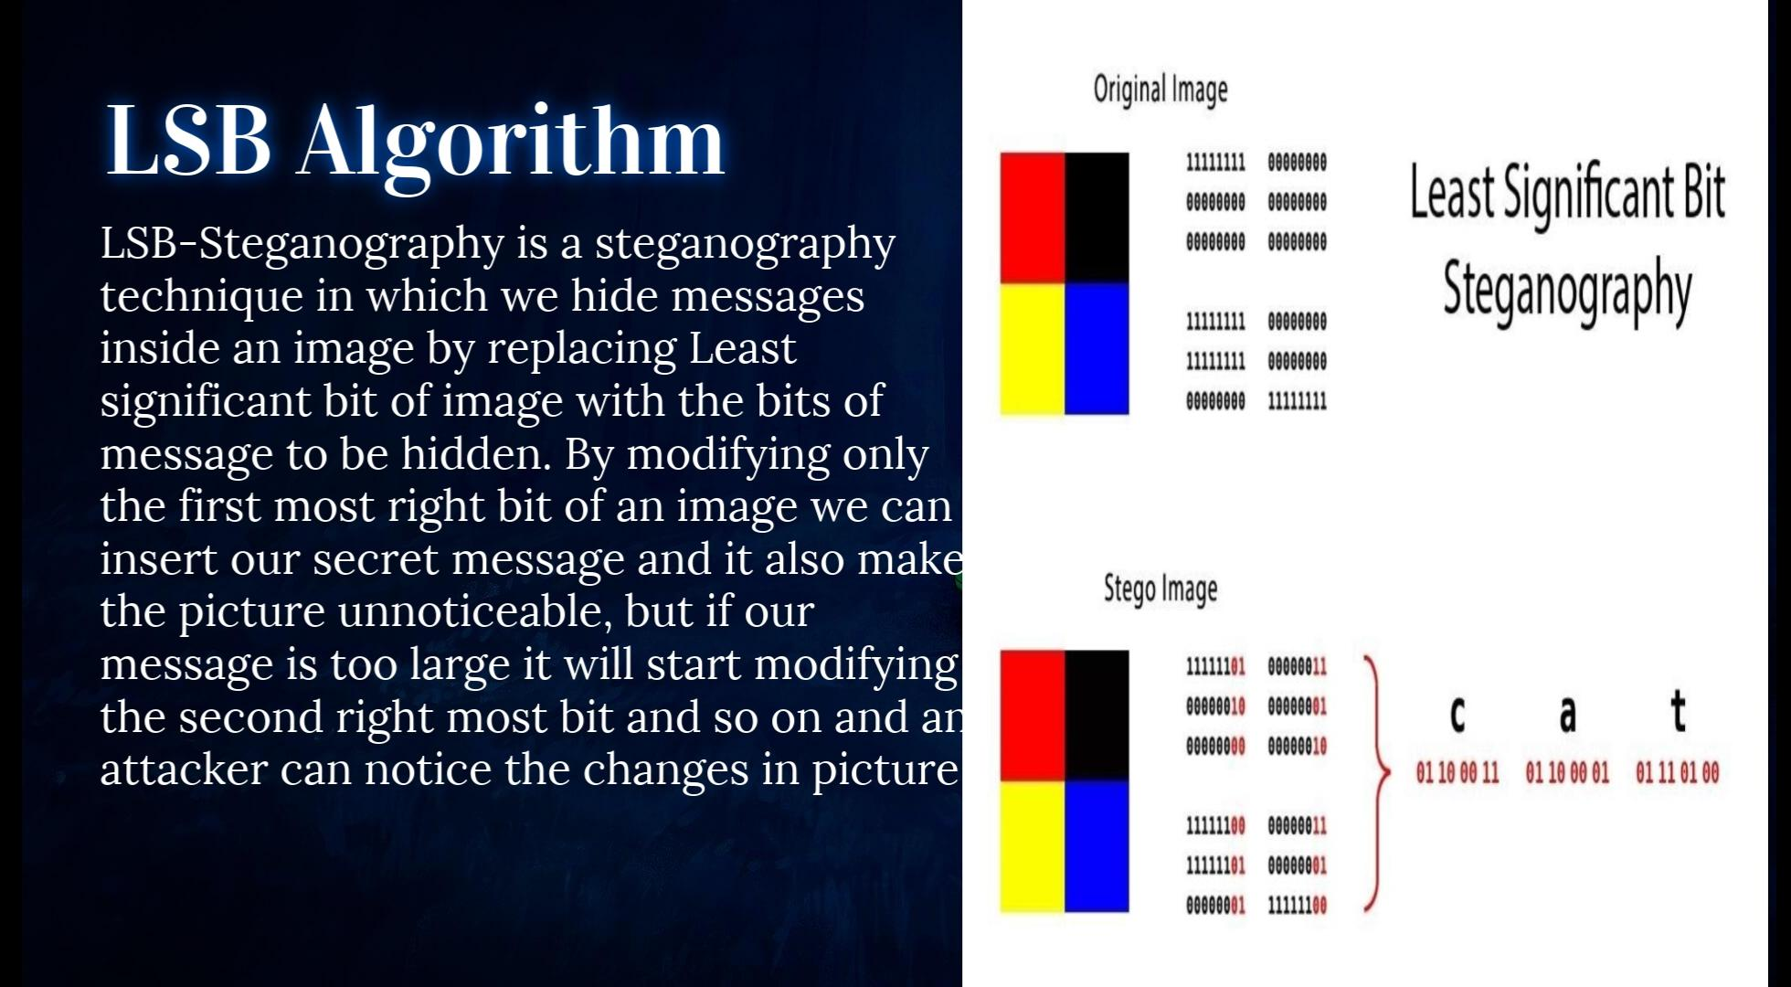


11

Slide 12
Encode of Image
Encode function takes the secret message that will be displayed after decoding the image and takes the image’s file name. OpenFile function is used to select the file that is to be encoded and Encoder function encodes the image.
For example, every time you type a letter on the keyboard, it needs to be converted to a series of electric signals that the computer can understand. Under the widely used “ASCII” encoding system, the letter “A” gets converted to the binary signal 01000001 (in binary, this represents the number 65). In terms of the electric circuits, this is a series of signals: a 0 represents a low voltage and a 1 represents a high voltage.

Slide 13
Decode of Image
The Decoder works in a similar way to the encoder, but the other way around. It learns to read, instead of generate, these compressed code representations and generate images based on that info. It aims to minimize the loss while reconstructing, obviously. The output is evaluated by comparing the reconstructed image by the original one, using a Mean Square Error (MSE) – the more similar it is to the original, the smaller the error.

Slide 14
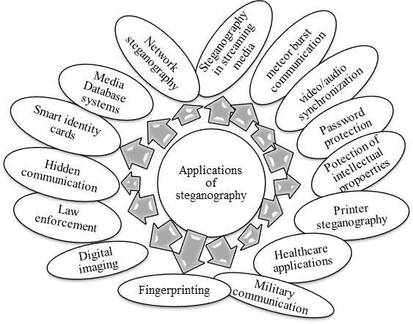
14

Slide 15
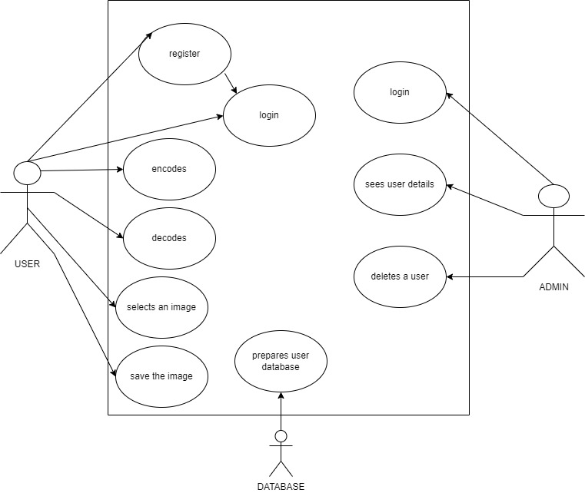

Slide 16
Use Case ID: UC01
Name: Register
Actors: User/Admin
Description: Allows new user to register for an account
Pre-conditions: None
Post-conditions: An account is created for the user
Main Flow:
User | System
Choose the register option
 | Prompts for the data required for registration
Enters the data prompted by the system.
 | Validates the information 1)If information is valid,create a new account 2)If the information is invalid,display error message and prompts for new values.

Slide 17
Use Case ID: UC02
Name: Login
Actors: User
Description: Allows registered users to Login
Pre-conditions: user should be registered with the system
Post-conditions: User logs in and all the options are displayed on the screen
Main Flow:
User | System
Enters the username and password and chooses Login option
 | Validates username and password 1)If information is valid then displays stegano page 2)If the information is invalid,display error message and prompts for new values.

Slide 18
Use Case ID: UC03
Name: Encoding
Actors: User
Description: Allows user to select the image and enter the secret message
Pre-conditions: user should be registered with the system
Post-conditions: User selects the appropriate image to save the information
Main Flow:
User | System
Selects the image and enters the secret message to be stored in image
 | Saves the image in the system

Slide 19
Use Case ID: UC04
Name: Decoding
Actors: User
Description: Allows user to select the image and separate the secret message from image
Pre-conditions: user should be registered with the system
Post-conditions: User selects the appropriate image to read the secret message from it.
Main Flow:
User | System
Selects the image and clicks on decode
 | Secret message is obtained from the image and displayed

Slide 20
Test Case ID:TC01 | Use Case ID: UC01
Test Case Title : New User Registration
Test Case Description: If user is not already registered , the user will be able to register by providing details.
Test Steps: User goes to the register page and enters the required details Registration Successful | Expected Result: User Successfully Registered Actual Result: User Successfully Registered
Test Case ID:TC02 | Use Case ID:UC02
Test Case Title: User/Admin Login
Test Case Description: Already Registered User logs in to stegano page
Test Steps: User goes Login page and enters the username and password If details are correct ,Login Success and its redirected to the Stegano page | Expected Result: Login Successful if the details are correct. Actual Result: Login Successful if the details are correct.

Slide 21
Test Case ID: TC03 | Use Case ID:UC03
Test Case Title : Encoding
Test Case Description: User selects the image and enters the secret message and saves the image
Test Steps: 1 User selects the image 2 user enters the secret message 3 image saves successfully | Expected Result: Saves the image successfully along with secret message Actual Result: Image saved successfully along with secret message
Test Case ID: TC04 | Use Case ID:UC04
Test Case Title: Decoding
Test Case Description: Separation of Image and Secret message
Test Steps: 1 User selects the image 2 User selects decode option 3 User reads the secret message | Expected Result: Reads the secret message Actual Result: Successfully secret message is displayed

Slide 22
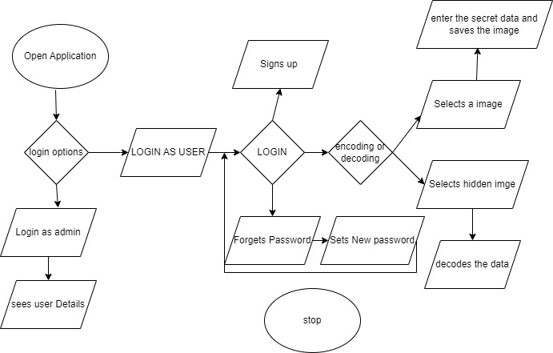
FLOW CHART

Slide 23
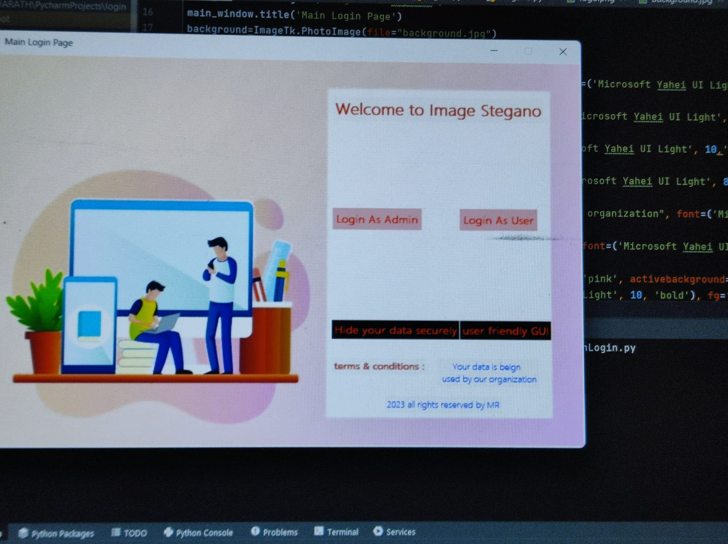
5. IMPLEMENTATION

Slide 24
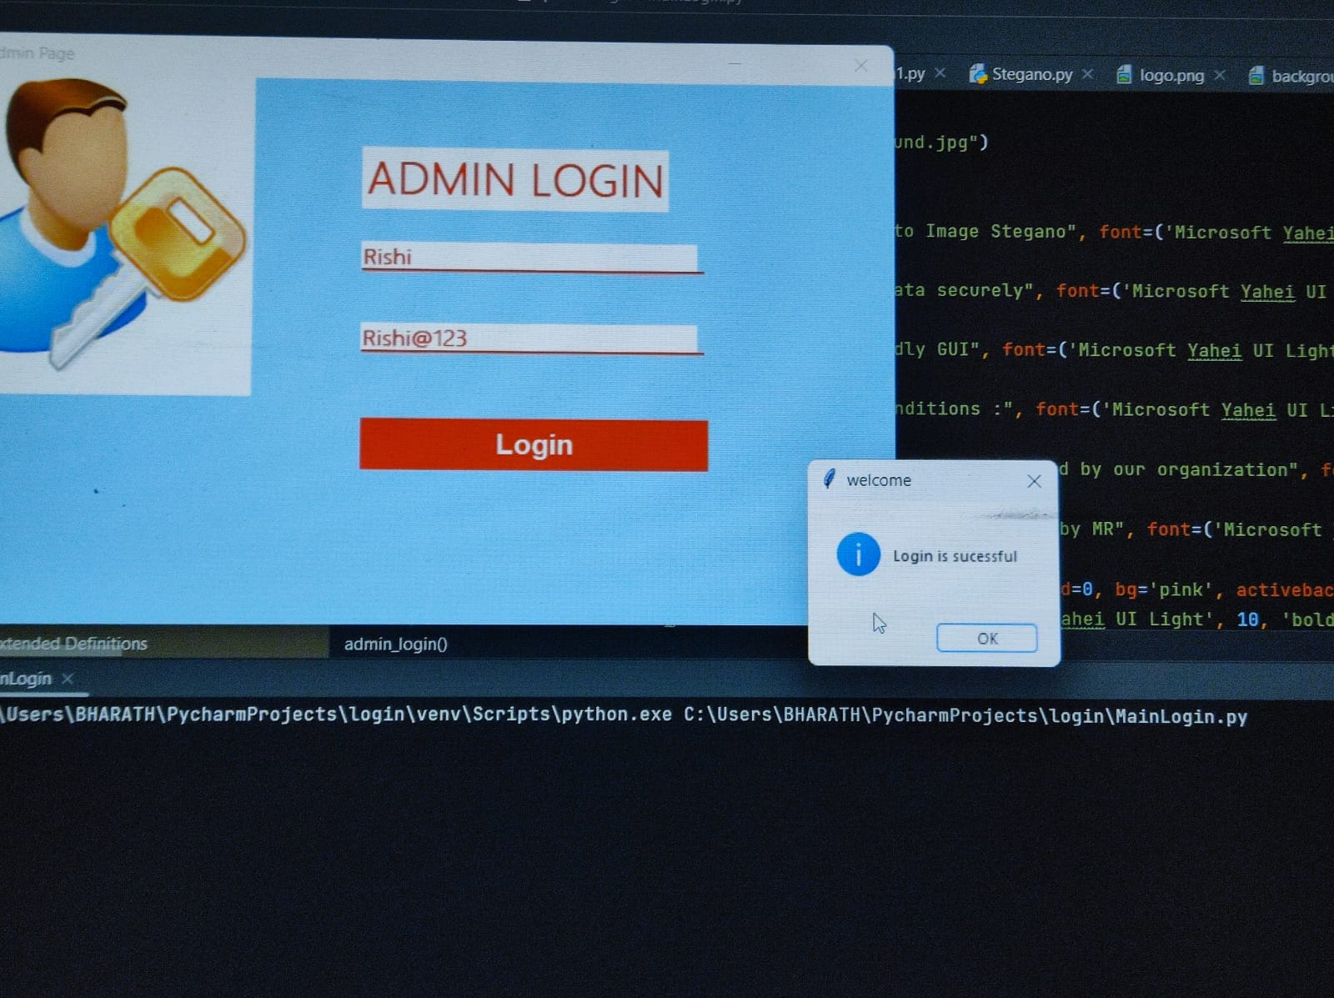
Admin login

Slide 25
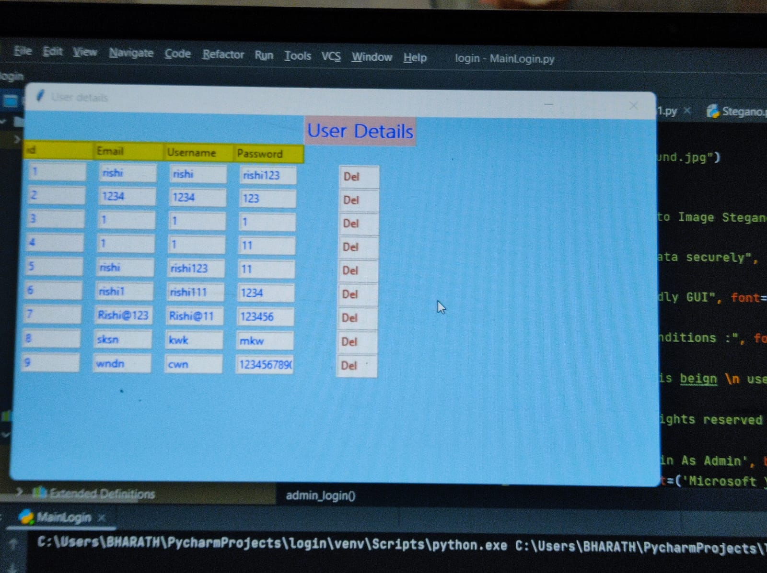
Admin Login

Slide 26
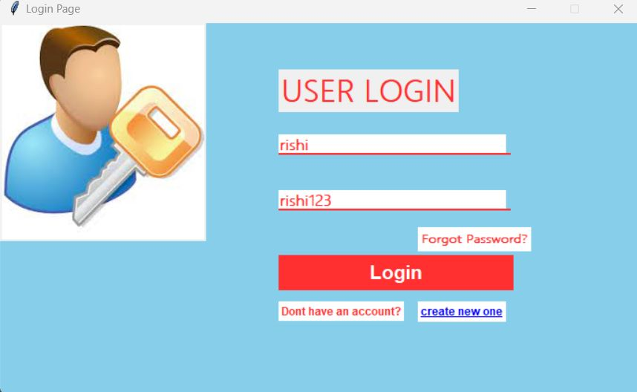
USER

Slide 27
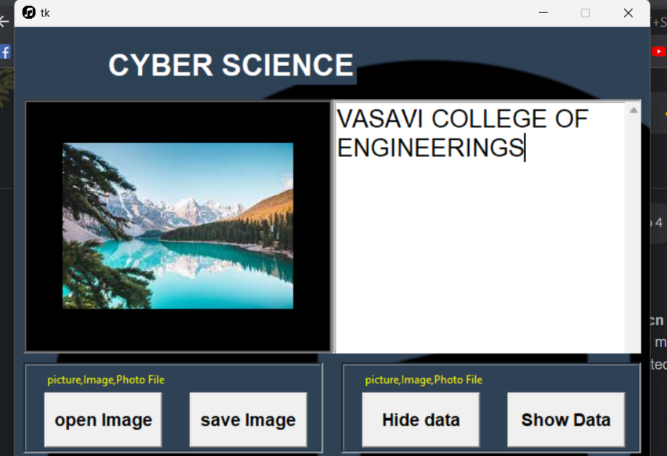

IMAGE STEGANOGRAPHY

Slide 28
6. CONCLUSION
We have successfully completed the python Image Steganography project with the help of Tkinter module. We have learned about the Tkinter and PIL modules. By using this, We can communicate with others secretly We also learned how to create buttons. Various functions were also used while developing this project. We can add many more functionalities to it, and make it more useful.

Slide 29
FUTURE RECOMMENDATIONS
The major limitation of the application is designed for images cover files. It accepts only images as a carrier file. The future work on this project is to improve the compression ratio of the image to the text. This project can be extended to a level such that it can be used for the different types of multimedia files

Slide 30


